Slide 1
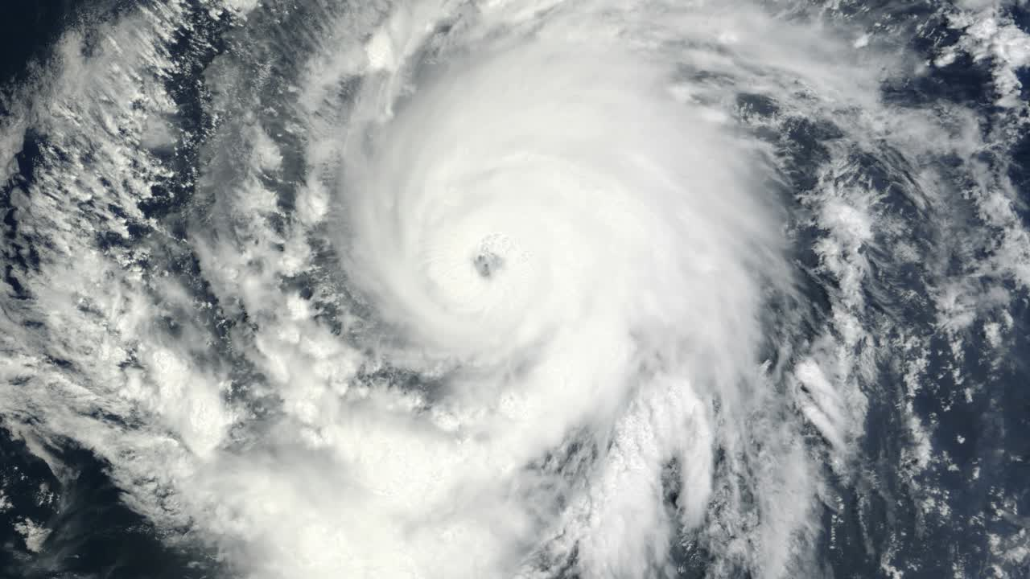
F21DL –
DATA MINING AND MACHINE LEARNING
OBJECTIVES
PREDICTING AND ANALYSING DAMAGE FROM HURRICANES AND TYPHOONS
01
Prediction:
Analysing numerical data to predict the formation and trajectory of hurricanes and typhoons, focusing on wind speeds, directions, and pressure
Presented By:
Joseph William Abdo
Thomson Thomas
Lubna Gulnaar
Irin Varughese
Joepaul Ettumanookaran
Damage Analysis:
Using satellite images to classify areas as "damage" or "no damage" to assess the extent of destruction to buildings, infrastructure, and landscapes
02

Slide 2
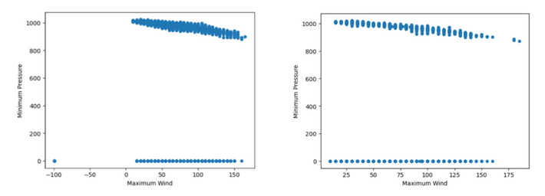
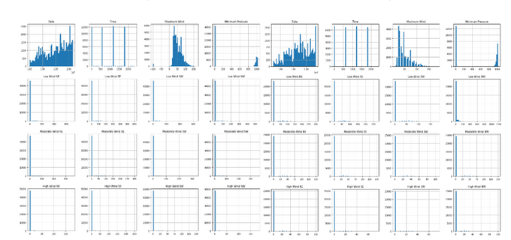
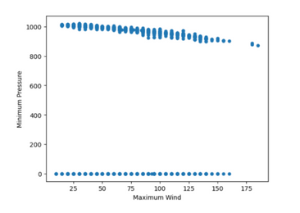
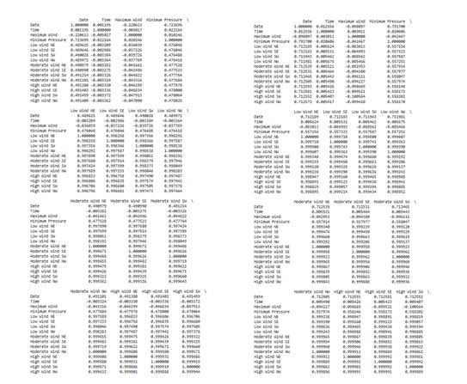
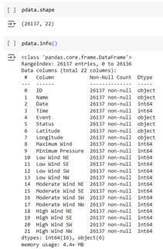
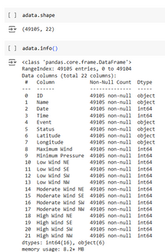
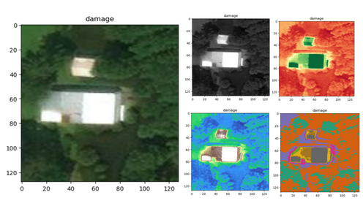
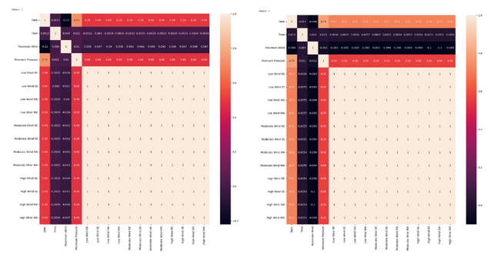
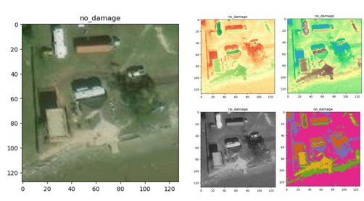
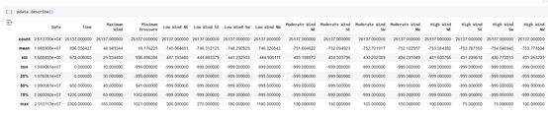
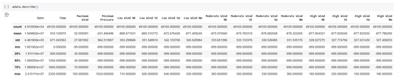
EXPLORATORY DATA ANALYSIS
The numerical dataset (loaded as a .CSV file) was analyzed using .info(), .describe(), and .shape() to examine its structure, data types, and key statistics such as value ranges and missing data
Rows with missing values were either removed or replaced to ensure data completeness and maintain dataset quality
The image dataset was preprocessed by normalizing and resizing the images
Random images from both the "damage" and "no damage" sets were plotted to verify the quality and correctness of the processed data.
Colormap application was tested to enhance feature visibility
HISTOGRAMS
SCATTER PLOTS
HEAT MAPS
CORRELATION MATRIX

Slide 3
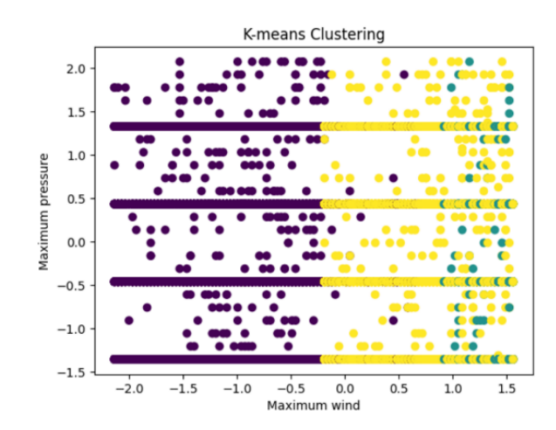
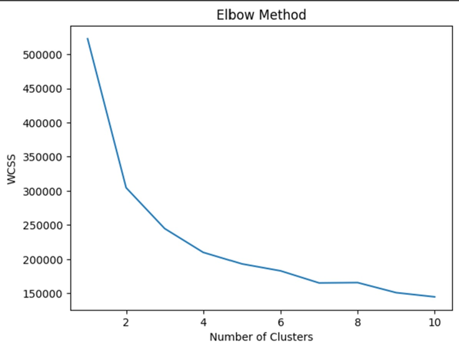
CLUSTERING USING K-MEANS
For clustering the K-Means algorithm with k=3 was used. The clusters showed distinct groupings representing low-intensity, moderate-intensity, and high-intensity storms.
The ones marked in purple represent hurricanes with moderate wind speeds and pressure. These likely represent average hurricanes.
Yellow represents hurricanes with higher wind speeds and lower pressure, which likely represents high intensity hurricanes.
Blue represents hurricanes with lower wind speeds and higher pressures, which are likely to represent low intensity hurricanes.
Choosing 3 clusters (K=3) was based on the analysis of the Elbow Method , which indicated that three distinct groups best represent the data’s structure. This clustering helps in capturing the complexity of hurricane categories without overfitting.
The clustering shows clear groupings, which could indicate distinct categories or intensities of hurricanes.

Slide 4
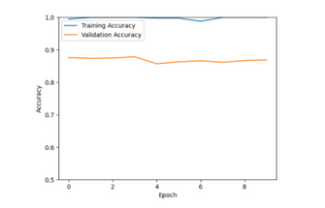
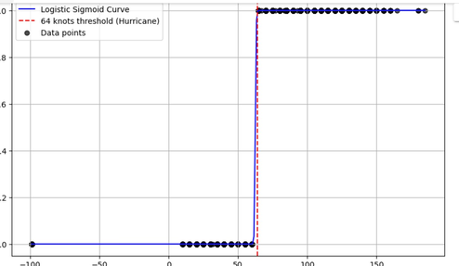
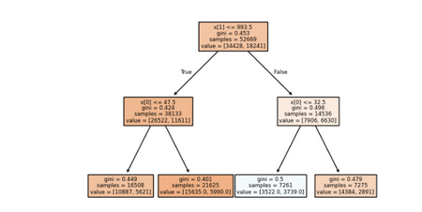
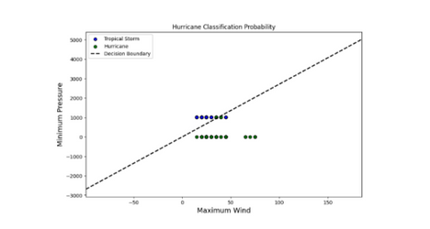
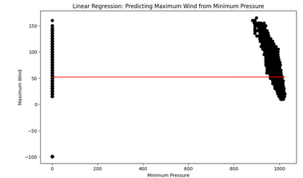
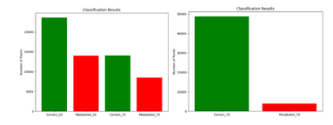
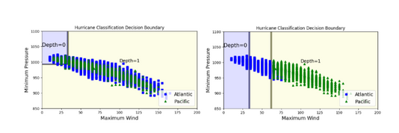
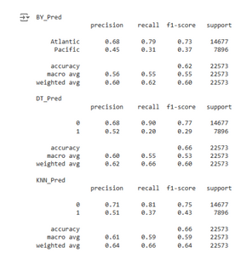
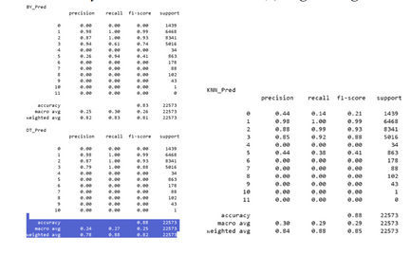
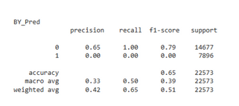
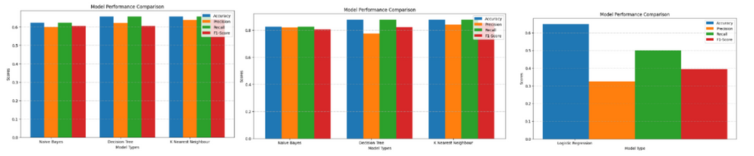
BASELINE TRAINING & NEURAL NETWORK
NAIVE BAYES
CNN
GRAPHS AND PLOTS
The dataset was tested using two configurations—50-50 and 70-30 splits.
GNB calculated mislabelled points by comparing predicted labels (y_pred) with actual labels (y_test).
A bar graph was used to compare results from both splits, assessing model performance.
A CNN was chosen for image processing because it recognizes patterns effectively
The dataset was split & the model was trained on segmented images
Images were processed through multiple layers, extracting key features and connecting them via fully connected layers
The process was repeated to enhance performance
KNN
LINEAR REGRESSION
KNN classified hurricane data into Atlantic (0) and Pacific (1) regions, using a 70/30 train-test split
The KNN classifier was then trained on the selected features, including Maximum Wind, Minimum Pressure, and Low Wind NE, with the number of neighbors set to 3
The model was evaluated by calculating its accuracy score on the test set and making predictions using new data points
Linear Regression analyzed the relationship between Minimum Pressure (feature) and Maximum Wind (target)
The date column was converted to datetime and set as the index for time-based analysis
Minimum Pressure was considered as the independent variable (feature) and Maximum Wind as the dependent variable (target)
COMPARING THE PREDICTIVE MODELS PERFORMANCES
DECISION TREES
LOGISTIC REGRESSION
Used for predicting storm regions (Atlantic/Pacific) and storm types (11 categories) using Maximum Wind and Minimum Pressure.
The tree structure (depth 2) was visualized to confirm accuracy in storm region prediction. Atlantic data had a broader Minimum Pressure range, while Pacific data showed extended Maximum Wind range.
Overlapping data between regions suggested similar storm characteristics. Improved classification (depth 1) for storm types reduced overlap, distinguishing Atlantic (higher pressure, lower wind) and Pacific (lower pressure, higher wind)
To predict hurricane occurrence using Maximum Wind and Minimum Pressure as features. Categorical target variables were encoded with LabelEncoder for compatibility
The dataset was split 70-30 for training and testing. The model's performance was assessed using a classification report with metrics such as accuracy, precision, recall, and F1-score.
Probability contours and decision boundaries were plotted

Slide 5
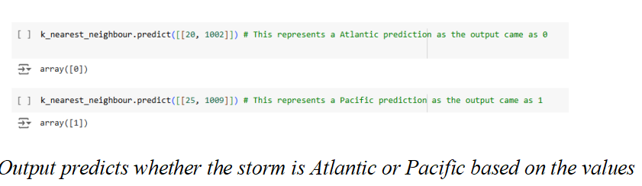
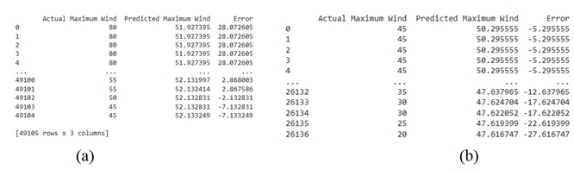
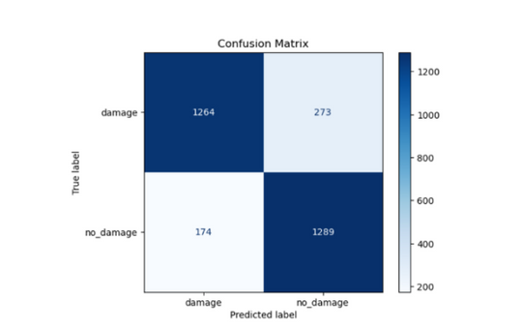
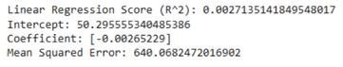
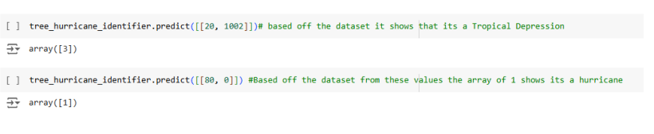
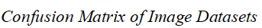
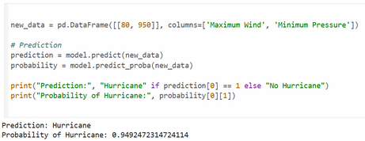
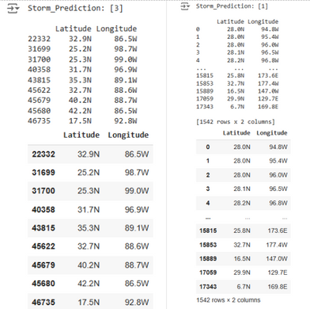
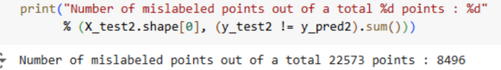
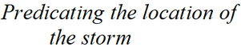
PREDICTIVE MODEL RESULTS & CONCLUSION
RESULTS DISCUSSION:
Based on the results, the project demonstrated that with a large numerical dataset, data may overlap in some cases, and using different methods can improve some model's scores and may improve the accuracy and information of the data. Furthermore, different data models show that they may have better accuracy but not as much precision and other such things as other data
CONCLUSION:
This project aimed at providing accurate results, being able to categorize not only the type of storm based on numerical data, but allowing the assessment of damage with satellite images of general areas. This allows for application in international storm watching and prediction use cases.

